Slide 2
Rebranding our Schools
Dispelling Urban Legends
Le Boler, Chief Strategist
Kristin Cutler, Media Relations Coordinator
Indianapolis Public Schools

Slide 3

then: headlines
Indianapolis Public Schools: More Than Half of Residents in District are Dissatisfied with School System
IPS Makes Boneheaded Move in Slashing Principals’ Salaries
School Corporation Grades Released: IPS Receives an “F”
Programmed to Fail: IPS’s Next Superintendent
Analysis Finds 10 Indiana “Dropout Factories”
IPS Fake Budget Deficit Shows Schools Need to be More Transparent

Slide 4
when legend becomes fact
Assess the situation
Solve the identity crisis
Recruit supporters and build believers
Change perceptions

Slide 5
assess the situation
The truth is…
What are people saying?
Does everyone feel that way?
S.W.O.T. * and P.E.S.T.** Analyses
What can good PR actually fix?
How much will it cost?
How do we bring others along?
Strengths, Weaknesses, Opportunities & Threats (stakeholder group participation)*
Political, Economic, Social, Technological (leadership exercise)**

Slide 6
solve the identity crisis
Who are we?
What do we believe?
What do we do well?
Confidence
Boosters!!

Slide 7
recruit supporters and build believers
“Proud to be Public”
Website
  School websites
Three-point social media
Complimentary collateral starter package
  Logos, Banner stand, table throw, business cards, stationery

Slide 8
myIPS.org
School Pages
Autonomy in sharing school news & info
Online Applications
General Enrollment
Pre-K Lottery
Magnet Program Lottery
District Headlines
App translates to 11 languages
Badges and Headers
Back to School
Strategic Plan
District Calendars
Sharing news and strategic communication
Ownership of school-specific photos and promotions

Slide 9
social media
Facebook, Twitter, and Instagram (all 60 schools!)
School-based experts trained on best practices
Toolkits issued for district promotions
Friendly competition among principals
Informational & promotional uses

Slide 10
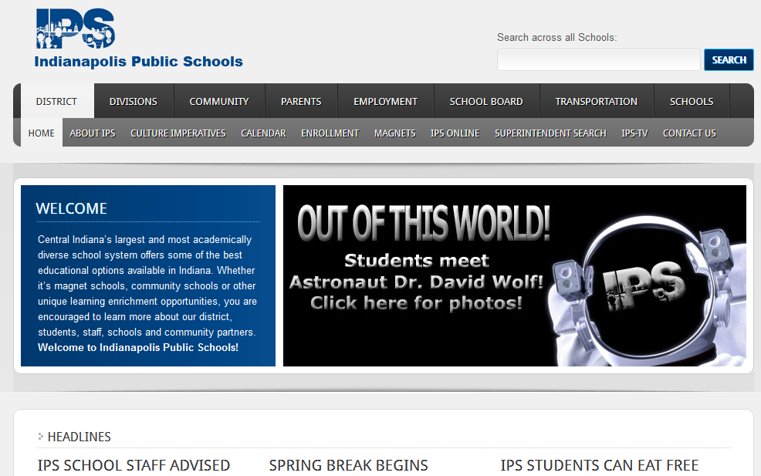
then: website

Slide 11
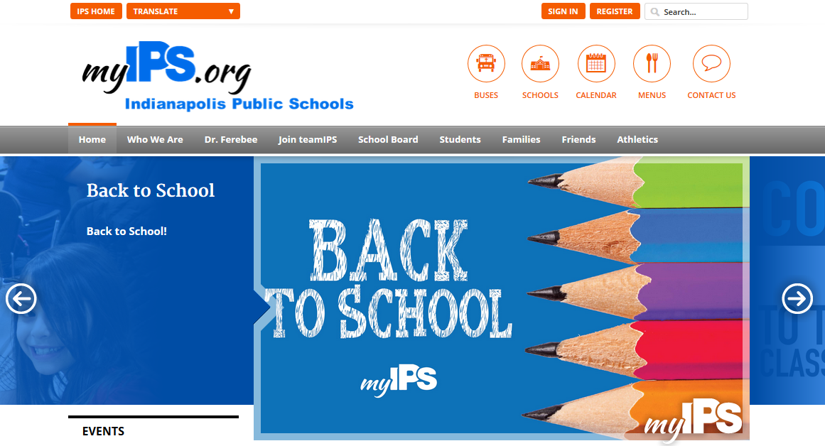
now: website

Slide 12
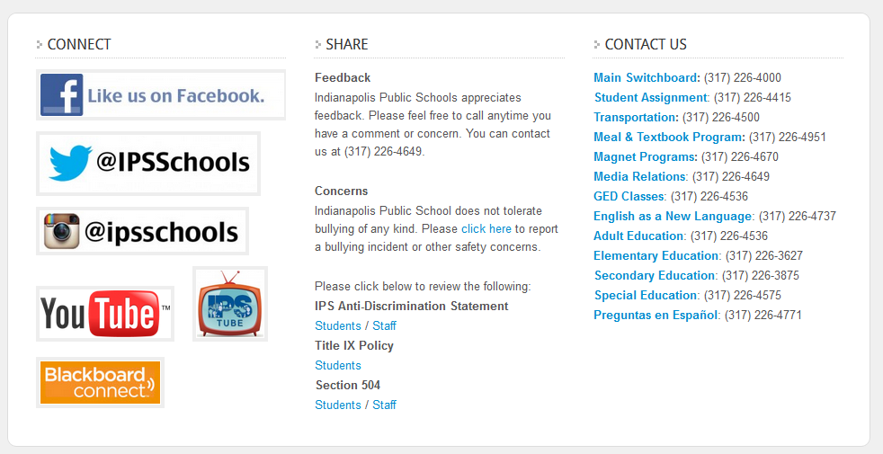
then: website

Slide 13
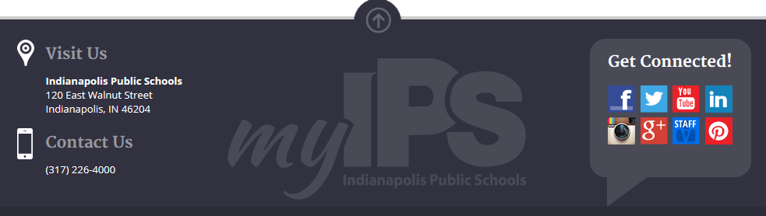
now: website

Slide 14
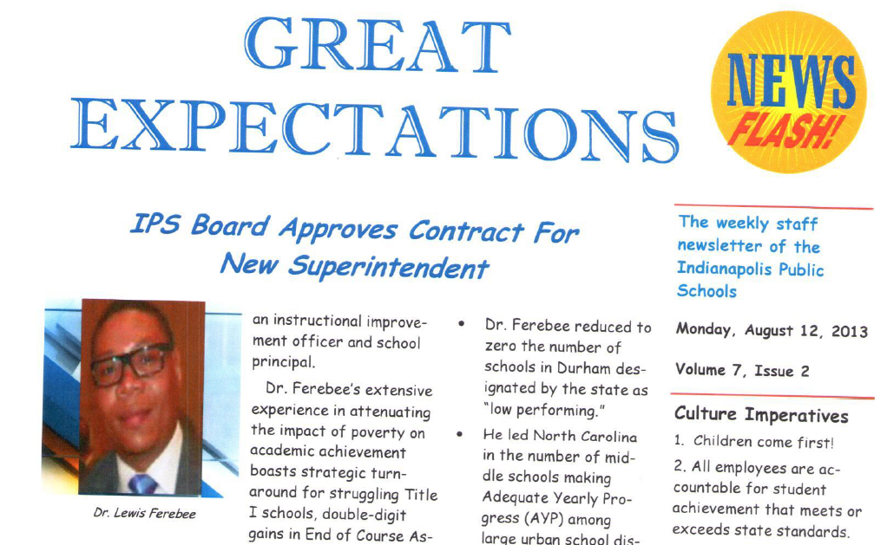
then: e-newsletters

Slide 15
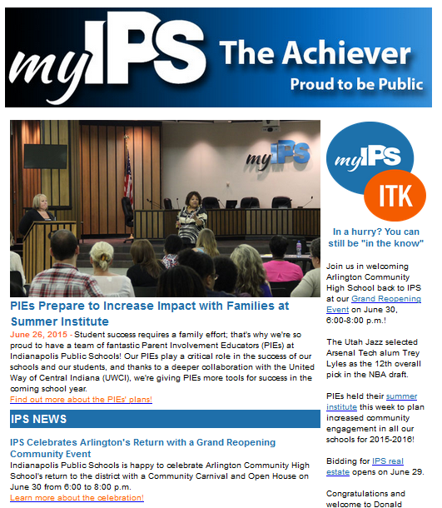
now: e-newsletters

Slide 16
change perceptions
More Training
Training
Toolkits
Brand Collateral
Strategic Lobbying Materials
Showcase of Schools
Events & Features
Profile/ Fact Sheet
Monitoring & Support
Improve and Expand

Slide 17
lessons and treasures
delta
On-staff Support
Board Involvement
plus
Media Relations
Ambassadors
Renewed Pride
Accelerated Efforts & Expectations
Expense ($$)

Slide 18
now: headlines
IPS Goes Non-Traditional to Attract Teachers, New Kids to District
IPS Approach to Improving Schools Could go Statewide
New IPS Superintendent Listening, Learning in Schools
New Dynamic Emerges in Indianapolis Public Schools
IPS Ranks No. 1 in National Study on Teacher Attendance
IPS Announces Free Breakfast, Lunch for All

Slide 19
Questions and Suggestions

